Slide 1

Q - Hackathon 2025,Mannheim
GenSetters. Built with GenAI. Made for trendsetting.
AI-Driven Career Copilot
GenSetters:
Harshith
Edilbert
Philipp
Revan
Paul

Slide 2





Learning that Fits — Not Learning that Fails
Inefficiency
Irrelevance
Inflexibility
Stagnation

Slide 3
IMPACT WE DELIVER
Relevance
01
Tailored courses based on Curriculum Vitae and interests
Effiency
02
Learn only what’s needed, not more
Engagement
03
Relevant content keeps users motivated
Impact
04
Higher outcomes, lower cost

Slide 4
IMPACT WE DELIVER
Relevance
01
Tailored courses based on Curriculum Vitae and interests
Effiency
02
Learn only what’s needed, not more
Engagement
03
Relevant content keeps users motivated
Impact
04
Higher outcomes, lower cost

Slide 5
IMPACT WE DELIVER
Relevance
01
Tailored courses based on Curriculum Vitae and interests
Effiency
02
Learn only what’s needed, not more
Engagement
03
Relevant content keeps users motivated
Impact
04
Higher outcomes, lower cost

Slide 6
IMPACT WE DELIVER
Relevance
01
Tailored courses based on Curriculum Vitae and interests
Effiency
02
Learn only what’s needed, not more
Engagement
03
Relevant content keeps users motivated
Impact
04
Higher outcomes, lower cost

Slide 7









GEN – erating, what really matters
Interest Finder
Content Shaper
Talk to AI. Define your path.
Weak points don’t stop you – they guide us.
CV Decoder
Course Composer
Smart Tester
We analyze your past to personalize your future.
Only the modules that matter.
AI-powered quizzes that actually teach

Slide 8
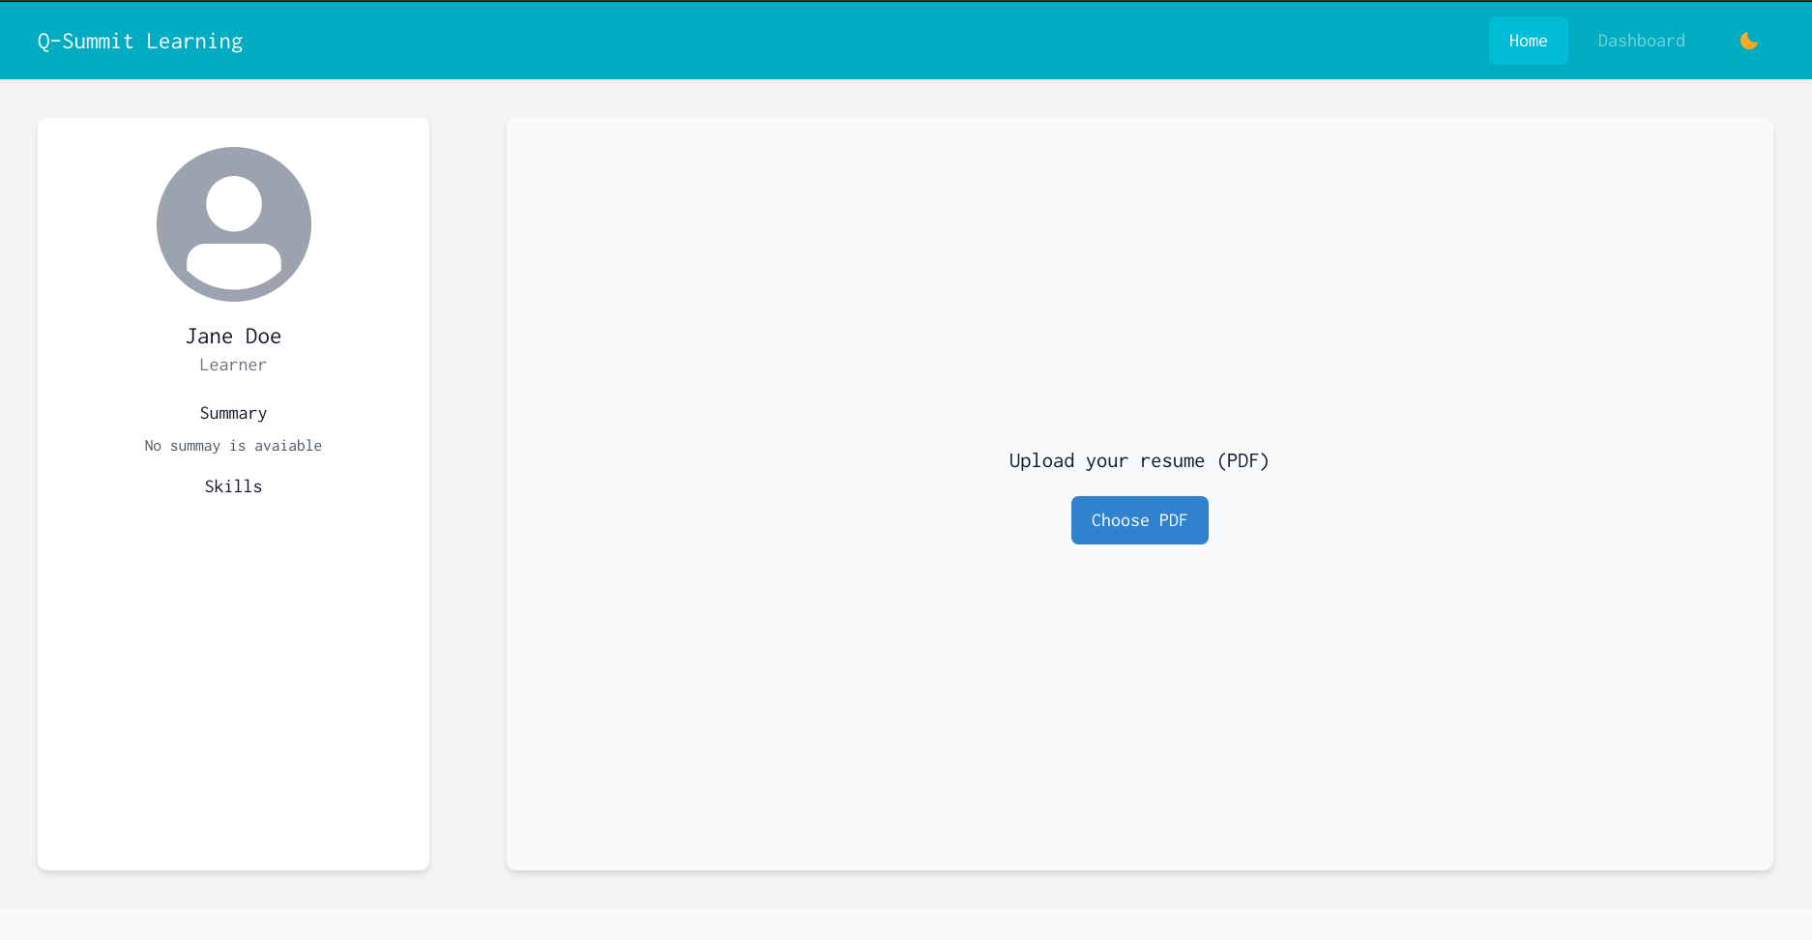

Slide 9
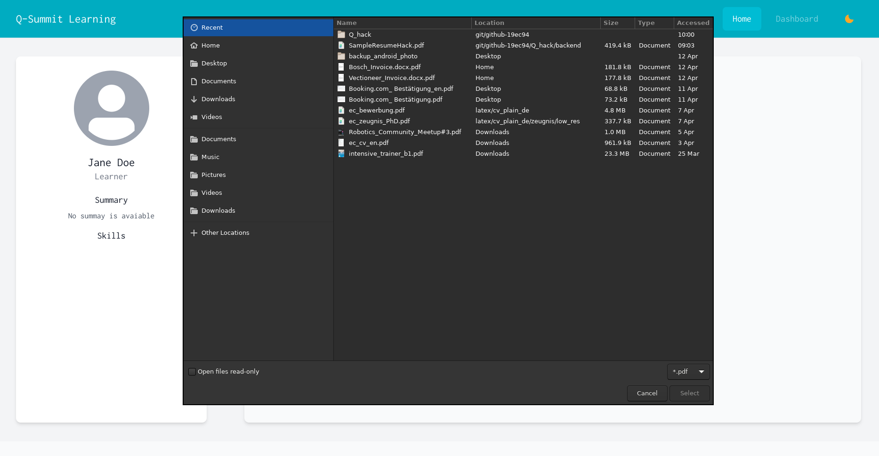

Slide 10
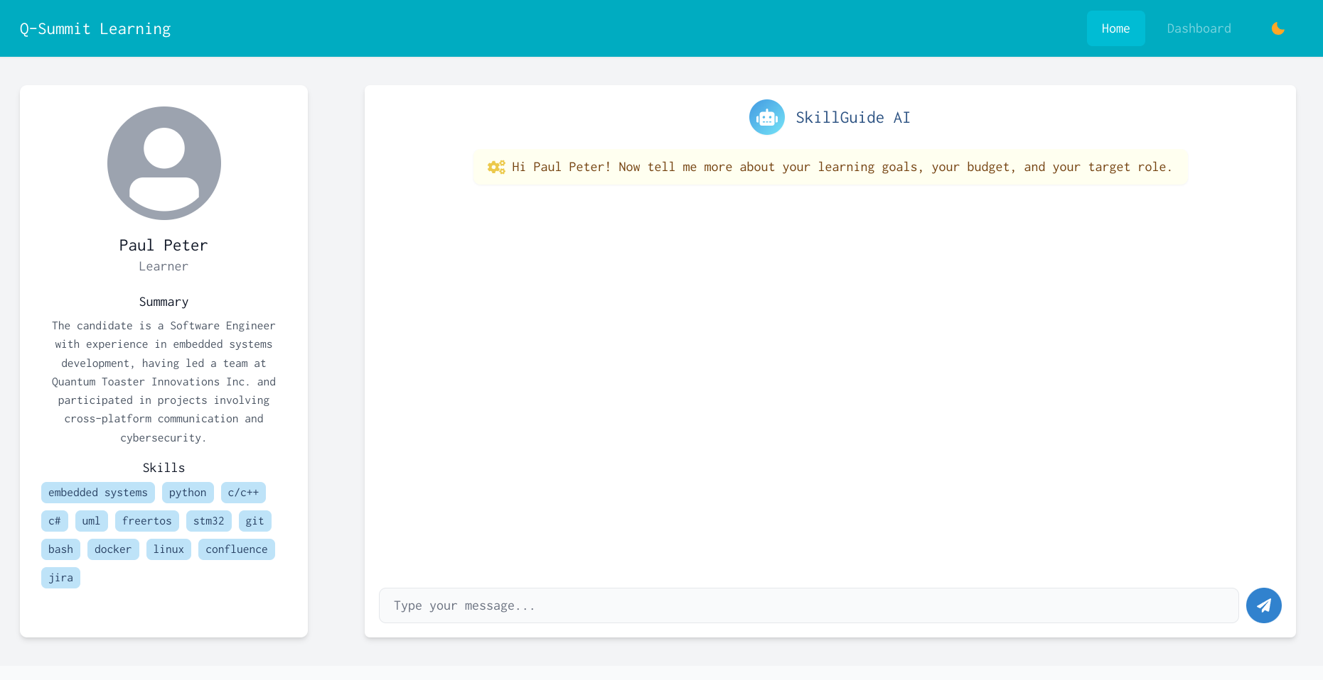

Slide 11
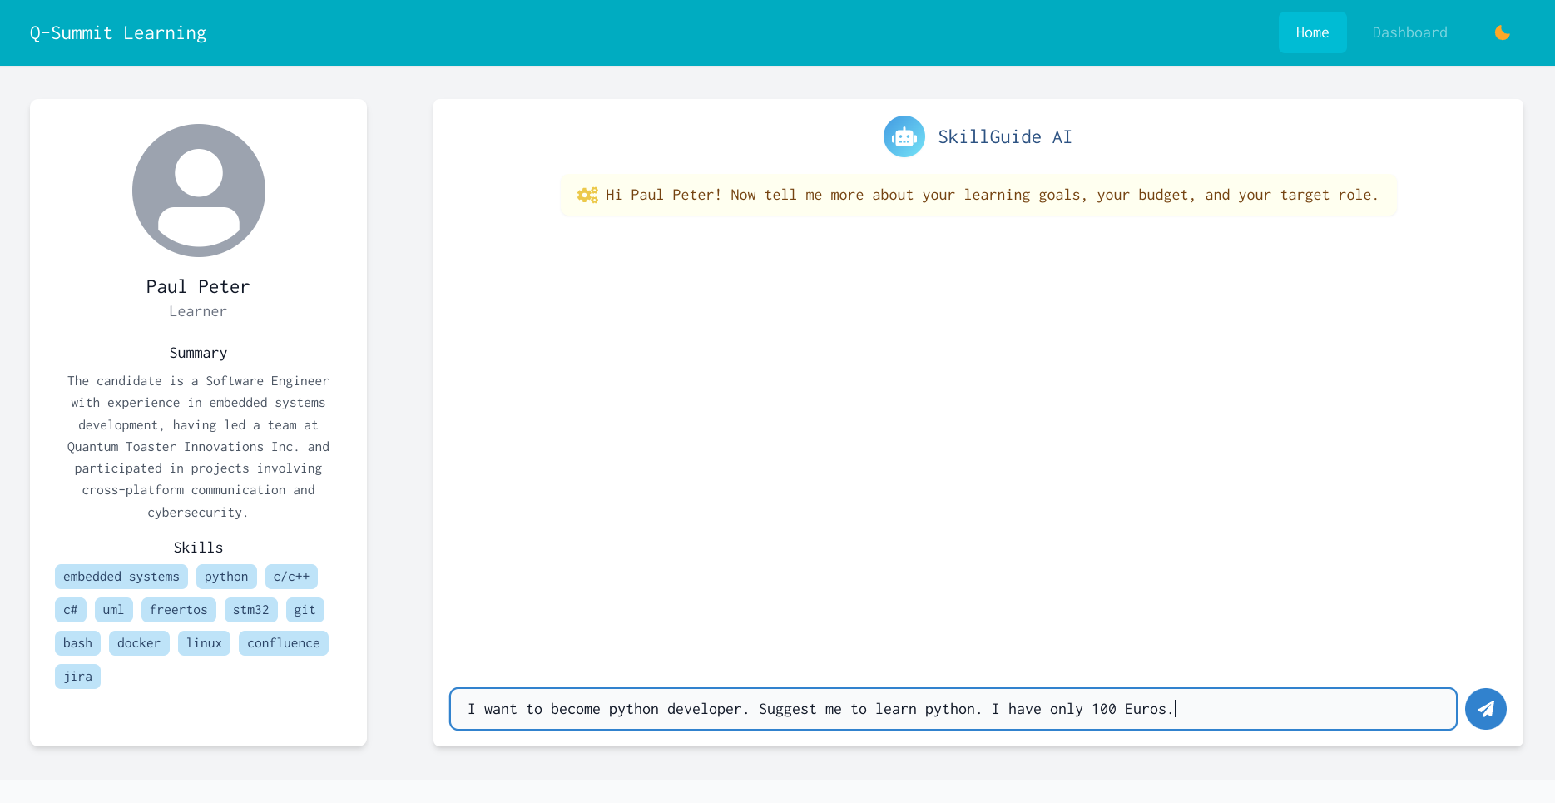

Slide 12
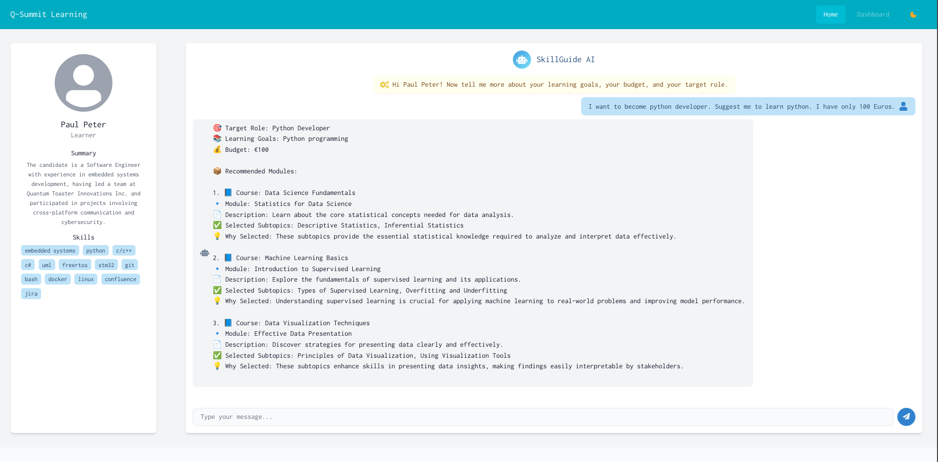

Slide 13
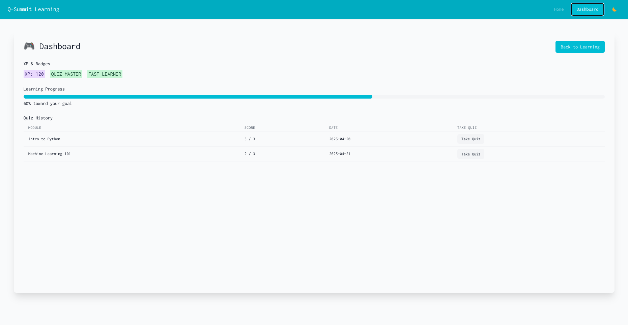

Slide 14
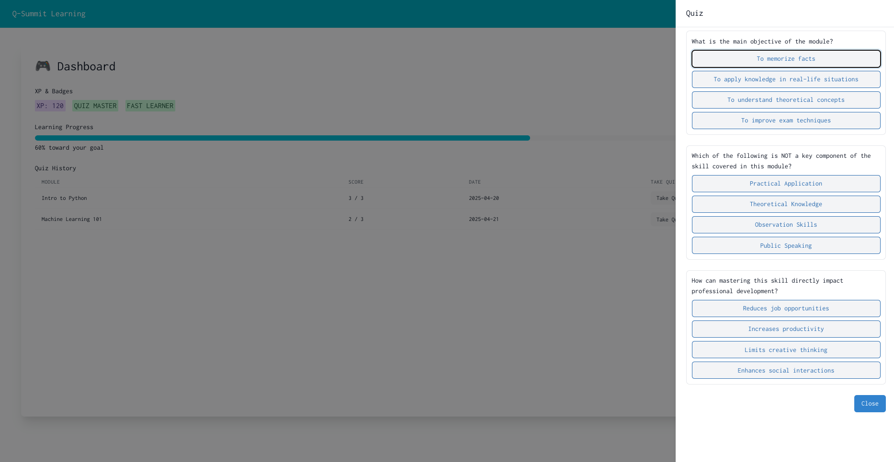

Slide 15
